Slide 1


Upper Coastal Plain Rural Planning Organization (UCPRPO)
TCC Meeting
September 1, 2020
Edgecombe County - Johnston County – Nash County – Wilson County
The meeting will begin at 2:00 PM
Please mute your line if you have not already done so.

Slide 2
UCPRPO TCC Meeting
Edgecombe County - Johnston County – Nash County – Wilson County
September 1, 2020
Meeting Guidelines
Please keep your microphone on mute until you are ready to make a comment or ask a questions.
Turn your microphone on to speak but remember to turn it off once you have finished.
Begin with stating your name so everyone will know who is speaking.
You may use the chat feature to send a note. The chat will be checked, but but please get my attention if I fail to respond quickly.
All votes will be completed by roll call as per NCGS 166A-19.24(b)(5). When the chair calls for a a vote, I will call roll and ask each person to respond with a ‘yes’ or ‘no’.
Please remember to mute yourself again after roll call.
Please keep microphone muted
Chat is enabled

Slide 3
UCPRPO TCC Meeting
Edgecombe County - Johnston County – Nash County – Wilson County
September 1, 2020
1. Welcome & Introductions – James Diggs – TCC Chair
ROLL CALL
2. REVIEW AGENDA FOR ADDITIONS OR CORRECTIONS

Slide 4
UCPRPO TCC Meeting
Edgecombe County - Johnston County – Nash County – Wilson County
September 1, 2020
3. APPROVAL OF UCPRPO TCC MEETING MINUTES
Review and approval of the March 3, 2020 minutes with a motion and second….. Then roll call

Slide 5
UCPRPO TCC Meeting
Edgecombe County - Johnston County – Nash County – Wilson County
September 1, 2020
4. Member updates from members around the Region
Roll call will be completed to allow each member an opportunity to provide updates from each member jurisdiction.

Slide 6
UCPRPO TCC Meeting
Edgecombe County - Johnston County – Nash County – Wilson County
September 1, 2020
5. Chair/Vice Chair Election for FY2021
UCPRPO TCC Bylaws state:
“The officers of the RTCC will consist of a Chairman and a Vice-Chairman serving annual terms, but limited to two (2) consecutive terms.”
Currently:
James Diggs, Wilson County is serving his first 1-year term as Chair.
Adam Tyson, Nash County is serving his first 1-year term as Vice Chair.
Nominations….
Roll Call for nominated Chair election
Roll Call for nominated Vice-Chair election

Slide 7
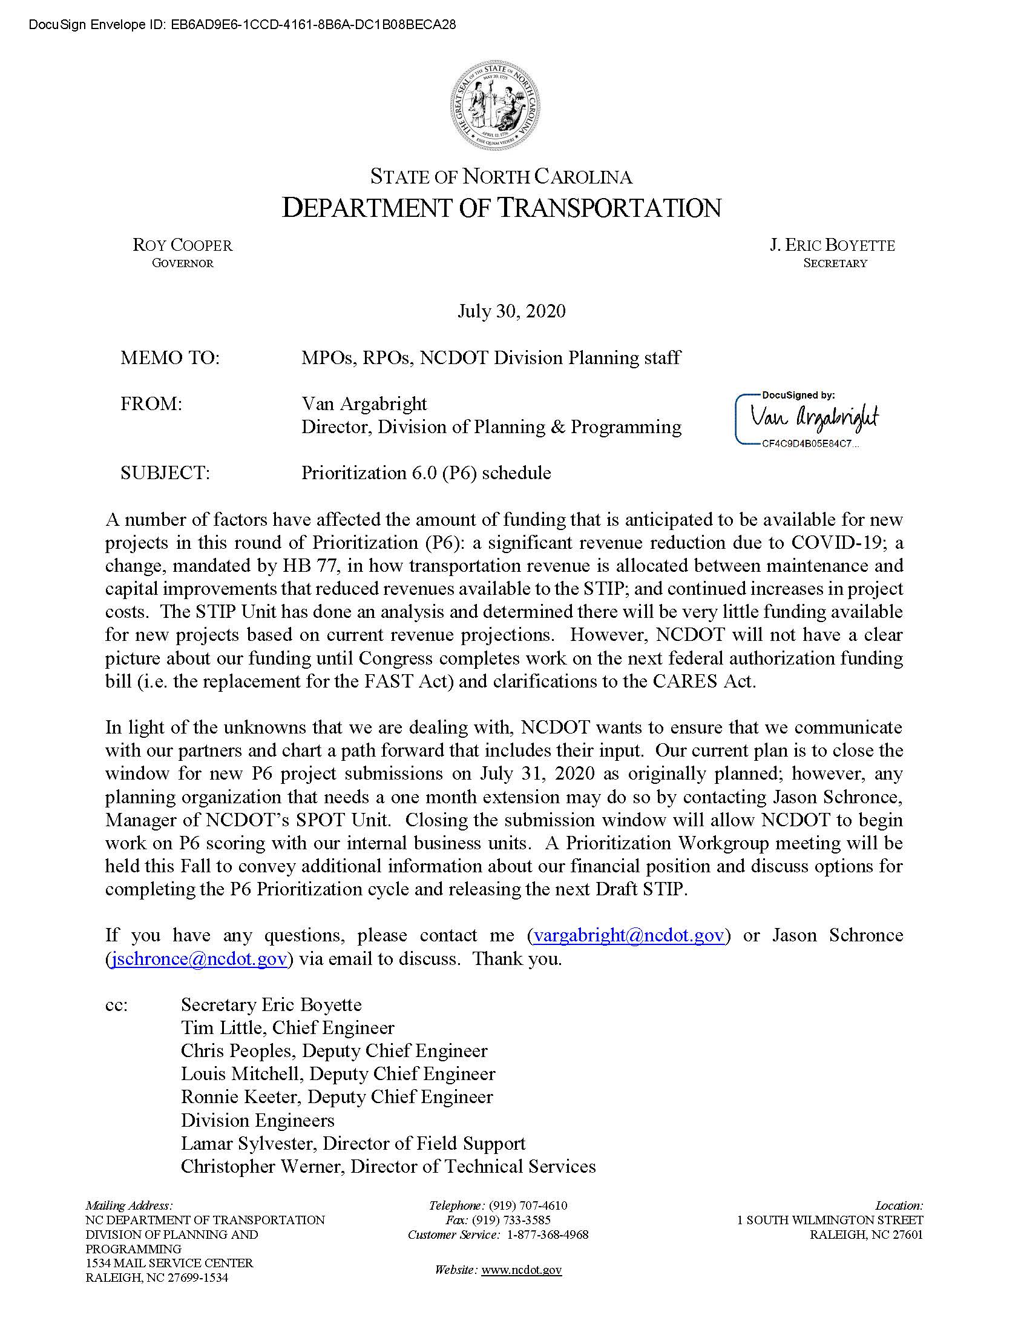
UCPRPO TCC Meeting
Edgecombe County - Johnston County – Nash County – Wilson County
September 1, 2020
6. STI P6 Prioritization Update
UCPRPO Projects were submitted into SPOT On!ine before the July 31, 2020 deadline.
As per July 30, 2020 NCDOT memo:
“The STIP Unit has done an analysis and determined there will be very little funding available for new projects based on current revenue projections. However, NCDOT will not have a clear picture about our funding until Congress completes work on the next federal authorization funding bill (i.e. the replacement for the FAST Act) and clarifications on the CARES Act.”
Note: The NC FIRST Commission continues to meet to find alternative revenue sources for transportation funding in North Carolina to recommend to the NC General Assembly. Maybe a Mileage-Based User Fee or Vehicle Miles Traveled?

Slide 8
UCPRPO TCC Meeting
Edgecombe County - Johnston County – Nash County – Wilson County
September 1, 2020
Prioritization P6 Next Steps:
October 23, 2020 - Area-Specific Weight Due
May 2021- Quantitative scores released with draft Statewide programming results
January-May 2021 – review/amend Local Input Point Methodology - deadline June 1, 2021
June 1, 2021 – Regional Needs Local Input window (project points allocation)
November 1, 2021 – Division Needs Local Input window (project points allocation)
May 2022 – Draft 2023-2032 STIP Released

Slide 9
UCPRPO TCC Meeting
Edgecombe County - Johnston County – Nash County – Wilson County
September 1, 2020
7. STIP FY2020-2029 Amendment Updates
The NC Board of Transportation is provided with amendments to the Statewide Transportation Improvement Program. The STIP updates reflect amendments presented to the Board for May, June, July, and August.

Slide 10
ITEM N (HANDOUT)
REVISIONS TO THE 2020-2029 STIP HIGHWAY PROGRAM
UPPER COASTAL PLAIN RURAL PLANNING ORGANIZATION
STIP MODIFICATIONS
US 258, REPLACE BRIDGE 320022 OVER TOWN CREEK. TO ASSIST IN BALANCING FUNDS, DELAY CONSTRUCTION FROM FY 20 TO FY 21.
B-4931 EDGECOMBE PROJ.CATEGORY DIVISION
- UPPER COASTAL PLAIN RURAL PLANNING ORGANIZATION
CONSTRUCTION
FY 2021 - $1,950,000 (HFB)
$1,950,000
B-4933 | - UPPER COASTAL PLAIN RURAL PLANNING | NC 33, REPLACE BRIDGE 320080 OVER TAR RIVER. | RIGHT-OF-WAY | FY 2023 - | $60,000 | (T)
EDGECOMBE | ORGANIZATION | REPLACE BRIDGE 320049 OVER TAR RIVER |  | FY 2024 - | $800,000 | (T)
PROJ.CATEGORY |  | OVERFLOW. | CONSTRUCTION | FY 2024 - | $4,600,000 | (NHPB)
REGIONAL |  | TO STRATEGICALLY BALANCE LETTINGS, DELAY |  | FY 2025 - | $4,600,000 | (NHPB)
 |  | RIGHT-OF-WAY FROM FY 20 TO FY 23 AND |  |  | $10,060,000
 |  | CONSTRUCTION FROM FY 21 TO FY 24.
B-5655 | - UPPER COASTAL PLAIN RURAL PLANNING | NC 111 / NC 122, REPLACE BRIDGE 320011 OVER TOWN | CONSTRUCTION | FY 2021 - | $1,950,000 | (HFB)
EDGECOMBE | ORGANIZATION | CREEK. |  |  | $1,950,000
PROJ.CATEGORY DIVISION |  | TO ASSIST IN BALANCING FUNDS, DELAY CONSTRUCTION FROM FY 20 TO FY 21.
* INDICATES FEDERAL AMENDMENT
Thursday, May 7, 2020

Slide 11
ITEM N (HANDOUT)
REVISIONS TO THE 2020-2029 STIP HIGHWAY PROGRAM
UPPER COASTAL PLAIN RURAL PLANNING ORGANIZATION
STIP MODIFICATIONS
B-5671 | - UPPER COASTAL PLAIN RURAL PLANNING | NC 97, BRIDGE 87 OVER SWIFT CREEK ON NC 97. | ENGINEERING | FY 2021 - | $17,000 | (T)
EDGECOMBE | ORGANIZATION | TO ASSIST IN BALANCING FUNDS, DELAY |  | FY 2022 - | $17,000 | (T)
PROJ.CATEGORY |  | CONSTRUCTION FROM FY 20 TO FY 21. |  | FY 2023 - | $17,000 | (T)
REGIONAL |  |  |  | FY 2024 - | $17,000 | (T)
 |  |  |  | FY 2025 - | $17,000 | (T)
 |  |  |  | FY 2026 - | $17,000 | (T)
 |  |  |  | FY 2027 - | $17,000 | (T)
 |  |  |  | FY 2028 - | $17,000 | (T)
 |  |  |  | FY 2029 - | $17,000 | (T)
 |  |  |  | POST YR- | $102,000 | (T)
 |  |  | BUILD NC CON | FY 2021 - | $86,000 | (T)
 |  |  |  | FY 2022 - | $86,000 | (T)
 |  |  |  | FY 2023 - | $86,000 | (T)
 |  |  |  | FY 2024 - | $86,000 | (T)
 |  |  |  | FY 2025 - | $86,000 | (T)
 |  |  |  | FY 2026 - | $86,000 | (T)
 |  |  |  | FY 2027 - | $86,000 | (T)
 |  |  |  | FY 2028 - | $86,000 | (T)
 |  |  |  | FY 2029 - | $86,000 | (T)
 |  |  |  | POST YR- | $516,000 | (T)
 |  |  | CONSTRUCTION | FY 2021 - | $725,000 | (T)
FY 2022 - $725,000 (T)
$2,995,000
FY 2021 - $1,200,000 (HFB)
$1,200,000
B-6002 EDGECOMBE PROJ.CATEGORY DIVISION
- UPPER COASTAL PLAIN RURAL PLANNING ORGANIZATION
SR 1126 (FAITH BAPTIST CHURCH ROAD), REPLACE BRIDGE 320064 OVER TOWN CREEK.
TO ASSIST IN BALANCING FUNDS, DELAY CONSTRUCTION FROM FY 20 TO FY 21.
CONSTRUCTION
* INDICATES FEDERAL AMENDMENT
Thursday, May 7, 2020

Slide 12
ITEM N (HANDOUT)
REVISIONS TO THE 2020-2029 STIP HIGHWAY PROGRAM
UPPER COASTAL PLAIN RURAL PLANNING ORGANIZATION
STIP MODIFICATIONS
B-6050 | - UPPER COASTAL PLAIN RURAL PLANNING | SR 2137 (PITTMAN ROAD) SR 2130 (E MAIN STREET) SR | RIGHT-OF-WAY | FY 2021 - | $1,500,000 | (NHPB)
JOHNSTON | ORGANIZATION | 2339 (BAGLEY ROAD), REPLACE BRIDGE 500109 ON SR | CONSTRUCTION | FY 2023 - | $5,000,000 | (NHPB)
PROJ.CATEGORY |  | 2137 (PITTMAN ROAD) OVER I-95, BRIDGE 500110 ON |  | FY 2024 - | $5,000,000 | (NHPB)
DIVISION |  | SR 2130 (EAST MAIN STREET) OVER I-95, AND BRIDGE |  | FY 2025 - | $5,000,000 | (NHPB)
 |  | 500112 ON SR 2339 (BAGLEY ROAD) OVER I-95. |  |  | $16,500,000
 |  | TO STRATEGICALLY BALANCE LETTINGS, DELAY CONSTRUCTION FROM FY 21 TO FY 23.
BR-0111 | - UPPER COASTAL PLAIN RURAL PLANNING | SR 1404 (SEVEN BRIDGES ROAD), REPLACE BRIDGE | RIGHT-OF-WAY | FY 2020 - | $420,000 | (O)
EDGECOMBE | ORGANIZATION | NO. 320003, 320004, 320005 OVER SWIFT CREEK ON SR | UTILITIES | FY 2020 - | $56,000 | (O)
PROJ.CATEGORY |  | 1404 (SEVEN BRIDGES ROAD). | CONSTRUCTION | FY 2021 - | $2,850,000 | (O)
DIVISION |  | TO ASSIST IN BALANCING FUNDS, DELAY |  | FY 2022 - | $2,850,000 | (O)
 |  | CONSTRUCTION FROM FY 20 TO FY 21. |  |  | $6,176,000
BR-0116 | - UPPER COASTAL PLAIN RURAL PLANNING | SR 1403 (COOPER ROAD), REPLACE BRIDGE 630080 | CONSTRUCTION | FY 2021 - | $700,000 | (HFB)
NASH | ORGANIZATION | OVER GIDEON SWAMP ON SR 1403 (COOPER ROAD). |  | FY 2022 - | $700,000 | (HFB)
PROJ.CATEGORY DIVISION |  | TO ASSIST IN BALANCING FUNDS, DELAY CONSTRUCTION FROM FY 20 TO FY 21. |  |  | $1,400,000
I-5986B | - UPPER COASTAL PLAIN RURAL PLANNING | I-95, SR 1002 (LONG BRANCH ROAD - EXIT 71) TO I-40 | RIGHT-OF-WAY | FY 2020 - | $2,105,000 | (T)
HARNETT | ORGANIZATION | (EXIT 81). WIDEN TO EIGHT LANES. |  | FY 2021 - | $39,995,000 | (T)
JOHNSTON | - MID-CAROLINA RURAL PLANNING | TO ASSIST IN BALANCING FUNDS, DELAY | UTILITIES | FY 2020 - | $700,000 | (T)
PROJ.CATEGORY | ORGANIZATION | CONSTRUCTION FROM FY 21 TO FY 22. | CONSTRUCTION | FY 2022 - | $20,466,000 | (T)
STATEWIDE |  |  |  | FY 2023 - | $20,467,000 | (T)
 |  |  |  | FY 2024 - | $20,467,000 | (T)
 |  |  |  |  | $104,200,000
* INDICATES FEDERAL AMENDMENT
Thursday, May 7, 2020

Slide 13
ITEM N (HANDOUT)
REVISIONS TO THE 2020-2029 STIP HIGHWAY PROGRAM
UPPER COASTAL PLAIN RURAL PLANNING ORGANIZATION
 |  | STIP MODIFICATIONS
I-6041 | - UPPER COASTAL PLAIN RURAL PLANNING | US 64 (FUTURE I-87), SR 1233 (THOMAS ROAD) | CONSTRUCTION | FY 2022 - | $4,195,000 | (NHPIM)
EDGECOMBE | ORGANIZATION | OVERPASS TO NC 33. PAVEMENT REHABILITATION. |  | FY 2023 - | $4,196,000 | (NHPIM)
PROJ.CATEGORY STATEWIDE |  | TO ASSIST IN BALANCING FUNDS, DELAY CONSTRUCTION FROM FY 21 TO FY 22. |  |  | $8,391,000
I-6041A | - UPPER COASTAL PLAIN RURAL PLANNING | US 64 (FUTURE I-87), REHABILITATE BRIDGE 320104, | CONSTRUCTION | FY 2023 - | $2,400,000 | (NHPIM)
EDGECOMBE PROJ.CATEGORY | ORGANIZATION | 320155, 320148, 320153, 320154, 320156, 320157, 320320, 320325, AND 320326. |  |  | $2,400,000
STATEWIDE |  | TO ASSIST IN BALANCING FUNDS, DELAY
 |  | CONSTRUCTION FROM FY 22 TO FY 23.
I-6042A | - UPPER COASTAL PLAIN RURAL PLANNING | US 64 (FUTURE I-87), REHABILITATE BRIDGE 320327 | CONSTRUCTION | FY 2023 - | $500,000 | (NHPIM)
EDGECOMBE | ORGANIZATION | AND 320328. |  |  | $500,000
PROJ.CATEGORY STATEWIDE |  | TO ASSIST IN BALANCING FUNDS, DELAY CONSTRUCTION FROM FY 22 TO FY 23.
R-5718 | - UPPER COASTAL PLAIN RURAL PLANNING | SR 1003 (BUFFALO ROAD), US 70 TO SR 1934 (OLD | RIGHT-OF-WAY | FY 2021 - | $560,000 | (T)
JOHNSTON | ORGANIZATION | BEULAH ROAD). WIDEN TO THREE LANES. | UTILITIES | FY 2021 - | $67,000 | (T)
PROJ.CATEGORY |  | TO ASSIST IN BALANCING FUNDS, DELAY RIGHT-OF- | CONSTRUCTION | FY 2023 - | $2,204,000 | (BG5200)
DIVISION |  | WAY FROM FY 20 TO FY 21. |  | FY 2024 - | $2,204,000 | (BG5200)
 |  |  |  | FY 2025 - | $2,204,000 | (BG5200)
 |  |  |  |  | $7,239,000
* INDICATES FEDERAL AMENDMENT
Thursday, May 7, 2020

Slide 14
ITEM N (HANDOUT)
REVISIONS TO THE 2020-2029 STIP HIGHWAY PROGRAM
UPPER COASTAL PLAIN RURAL PLANNING ORGANIZATION
STIP MODIFICATIONS
W-5804A
WILSON PROJ.CATEGORY REGIONAL
- UPPER COASTAL PLAIN RURAL PLANNING ORGANIZATION
US 301, US 301 AT NC 581. CONSTRUCT A REDUCED CONFLICT INTERSECTION WITH TRUCK BULB-OUTS AT THE ADJACENT U-TURN POINTS.
TO ASSIST IN BALANCING FUNDS, DELAY RIGHT-OF- WAY FROM FY 20 TO FY 21 AND CONSTRUCTION FROM FY 21 TO FY 22.
RIGHT-OF-WAY FY 2021 - $100,000 (HSIP)
CONSTRUCTION FY 2022 - $854,000 (HSIP)
$954,000
* INDICATES FEDERAL AMENDMENT
Thursday, May 7, 2020

Slide 15
ITEM N (HANDOUT)
REVISIONS TO THE 2020-2029 STIP HIGHWAY PROGRAM
UPPER COASTAL PLAIN RURAL PLANNING ORGANIZATION
STIP ADDITIONS
VARIOUS, SAFETY IMPROVEMENTS AT VARIOUS LOCATIONS IN DIVISION 4.
PROJECT ADDED AT REQUEST OF TRANSPORTATION MOBILITY AND SAFETY; INDIVIDUAL PROJECTS AND FUNDING TO BE REQUESTED IN THE FUTURE AS NEEDED.
* HS-2004 EDGECOMBE HALIFAX JOHNSTON NASH WAYNE WILSON
PROJ.CATEGORY STATEWIDE REGIONAL DIVISION
ROCKY MOUNT METROPOLITAN PLANNING ORGANIZATION
GOLDSBORO URBAN AREA METROPOLITAN PLANNING ORGANIZATION
PEANUT BELT RURAL PLANNING ORGANIZATION
EASTERN CAROLINA RURAL PLANNING ORGANIZATION
UPPER COASTAL PLAIN RURAL PLANNING ORGANIZATION
* RC-2004 EDGECOMBE HALIFAX JOHNSTON NASH WAYNE WILSON
PROJ.CATEGORY
DIVISION
ROCKY MOUNT METROPOLITAN PLANNING ORGANIZATION
GOLDSBORO URBAN AREA METROPOLITAN PLANNING ORGANIZATION
PEANUT BELT RURAL PLANNING ORGANIZATION
EASTERN CAROLINA RURAL PLANNING ORGANIZATION
UPPER COASTAL PLAIN RURAL PLANNING ORGANIZATION
VARIOUS, TRAFFIC SEPARATION STUDY IMPLEMENTATION AND CLOSURES IN DIVISION 4.
PROJECT ADDED AT REQUEST OF RAIL DIVISION; INDIVIDUAL PROJECTS AND FUNDING TO BE REQUESTED IN THE FUTURE AS NEEDED.
* INDICATES FEDERAL AMENDMENT
Thursday, June 4, 2020
189

Slide 16
ITEM N (HANDOUT)
REVISIONS TO THE 2020-2029 STIP HIGHWAY PROGRAM
UPPER COASTAL PLAIN RURAL PLANNING ORGANIZATION
STIP ADDITIONS
* RX-2004 EDGECOMBE HALIFAX JOHNSTON NASH WAYNE WILSON
PROJ.CATEGORY
DIVISION
- ROCKY MOUNT METROPOLITAN PLANNING VARIOUS, HIGHWAY-RAIL GRADE CROSSING SAFETY
ORGANIZATION
- GOLDSBORO URBAN AREA
IMPROVEMENTS IN DIVISION 4.
PROJECT ADDED AT REQUEST OF RAIL DIVISION;
METROPOLITAN PLANNING ORGANIZATION INDIVIDUAL PROJECTS AND FUNDING TO BE
PEANUT BELT RURAL PLANNING ORGANIZATION
EASTERN CAROLINA RURAL PLANNING ORGANIZATION
UPPER COASTAL PLAIN RURAL PLANNING ORGANIZATION
REQUESTED IN THE FUTURE AS NEEDED.
* INDICATES FEDERAL AMENDMENT
Thursday, June 4, 2020
190

Slide 17
ITEM N (HANDOUT)
REVISIONS TO THE 2020-2029 STIP HIGHWAY PROGRAM
UPPER COASTAL PLAIN RURAL PLANNING ORGANIZATION
 |  | STIP MODIFICATIONS
BR-0036 | - UPPER COASTAL PLAIN RURAL PLANNING | NC 33, BRIDGE 630041 ON NC 33 OVER I-95. | ENGINEERING | FY 2021 - | $26,000 | (T)
NASH | ORGANIZATION | TO ASSIST IN BALANCING FUNDS, DELAY |  | FY 2022 - | $26,000 | (T)
PROJ.CATEGORY |  | CONSTRUCTION FROM FY 20 TO FY 21. |  | FY 2023 - | $26,000 | (T)
REGIONAL |  |  |  | FY 2024 - | $26,000 | (T)
 |  |  |  | FY 2025 - | $26,000 | (T)
 |  |  |  | FY 2026 - | $26,000 | (T)
 |  |  |  | FY 2027 - | $26,000 | (T)
 |  |  |  | FY 2028 - | $26,000 | (T)
 |  |  |  | FY 2029 - | $26,000 | (T)
 |  |  |  | POST YR- | $156,000 | (T)
 |  |  | BUILD NC CON | FY 2021 - | $215,000 | (T)
 |  |  |  | FY 2022 - | $215,000 | (T)
 |  |  |  | FY 2023 - | $215,000 | (T)
 |  |  |  | FY 2024 - | $215,000 | (T)
 |  |  |  | FY 2025 - | $215,000 | (T)
 |  |  |  | FY 2026 - | $215,000 | (T)
 |  |  |  | FY 2027 - | $215,000 | (T)
 |  |  |  | FY 2028 - | $215,000 | (T)
 |  |  |  | FY 2029 - | $215,000 | (T)
 |  |  |  | POST YR- | $1,290,000 | (T)
 |  |  | CONSTRUCTION | FY 2021 - | $1,100,000 | (T)
FY 2022 - $1,100,000 |  |  |  |  |  | (T)
$5,815,000
* INDICATES FEDERAL AMENDMENT
Thursday, June 4, 2020
191

Slide 18
ITEM N (HANDOUT)
REVISIONS TO THE 2020-2029 STIP HIGHWAY PROGRAM
UPPER COASTAL PLAIN RURAL PLANNING ORGANIZATION
 |  | STIP MODIFICATIONS
BR-0039 | - UPPER COASTAL PLAIN RURAL PLANNING | SR 1510, BRIDGE 224 ON SR 1510 OVER I-95. | ENGINEERING | FY 2021 - | $26,000 | (T)
NASH | ORGANIZATION | TO ASSIST IN BALANCING FUNDS, DELAY |  | FY 2022 - | $26,000 | (T)
PROJ.CATEGORY |  | CONSTRUCTION FROM FY 20 TO FY 21. |  | FY 2023 - | $26,000 | (T)
DIVISION |  |  |  | FY 2024 - | $26,000 | (T)
 |  |  |  | FY 2025 - | $26,000 | (T)
 |  |  |  | FY 2026 - | $26,000 | (T)
 |  |  |  | FY 2027 - | $26,000 | (T)
 |  |  |  | FY 2028 - | $26,000 | (T)
 |  |  |  | FY 2029 - | $26,000 | (T)
 |  |  |  | POST YR- | $156,000 | (T)
 |  |  | BUILD NC CON | FY 2021 - | $215,000 | (T)
 |  |  |  | FY 2022 - | $215,000 | (T)
 |  |  |  | FY 2023 - | $215,000 | (T)
 |  |  |  | FY 2024 - | $215,000 | (T)
 |  |  |  | FY 2025 - | $215,000 | (T)
 |  |  |  | FY 2026 - | $215,000 | (T)
 |  |  |  | FY 2027 - | $215,000 | (T)
 |  |  |  | FY 2028 - | $215,000 | (T)
 |  |  |  | FY 2029 - | $215,000 | (T)
 |  |  |  | POST YR- | $1,290,000 | (T)
 |  |  | CONSTRUCTION | FY 2021 - | $1,350,000 | (T)
 |  |  |  | FY 2022 - $1,350,000 |  | (T)
 |  |  |  | $6,315,000
I-6046 | - ROCKY MOUNT METROPOLITAN PLANNING | US 64 (FUTURE I-87), SR 1603 (OLD CARRIAGE ROAD) | CONSTRUCTION | FY 2022 - $8,850,000 |  | (NHPIM)
EDGECOMBE NASH PROJ.CATEGORY STATEWIDE | ORGANIZATION - UPPER COASTAL PLAIN RURAL PLANNING ORGANIZATION | TO SR 1225 (KINGSBORO ROAD). PAVEMENT REHABILITATION. TO ASSIST IN BALANCING FUNDS, DELAY CONSTRUCTION FROM FY 21 TO FY 22. |  | FY 2023 - $8,850,000 $17,700,000 |  | (NHPIM)
* INDICATES FEDERAL AMENDMENT
Thursday, June 4, 2020
192

Slide 19
ITEM N (HANDOUT)
REVISIONS TO THE 2020-2029 STIP HIGHWAY PROGRAM
UPPER COASTAL PLAIN RURAL PLANNING ORGANIZATION
STIP MODIFICATIONS
I-5986C | - ROCKY MOUNT METROPOLITAN PLANNING | I-95, INSTALL BROADBAND FIBER ALONG I-95 FROM | CONSTRUCTION | FY 2021 - | $210,000 | (T)
CUMBERLAND | ORGANIZATION | SOUTH CAROLINA LINE TO VIRGINIA STATE LINE. |  | FY 2021 - | $16,600,000 | (O)
HALIFAX HARNETT | - FAYETTEVILLE URBANIZED AREA METROPOLITAN PLANNING ORGANIZATION | TO ALLOW ADDITIONAL TIME FOR PROCUREMENT, DELAY CONSTRUCTION FROM FY 20 TO FY 21. |  |  | $16,810,000
JOHNSTON NASH NORTHAMPTON ROBESON WILSON
PROJ.CATEGORY
STATEWIDE
MID-CAROLINA RURAL PLANNING ORGANIZATION
PEANUT BELT RURAL PLANNING ORGANIZATION
LUMBER RIVER RURAL PLANNING ORGANIZATION
UPPER COASTAL PLAIN RURAL PLANNING ORGANIZATION
R-5777D CARTERET CRAVEN JOHNSTON LENOIR WAKE WAYNE
PROJ.CATEGORY
STATEWIDE
CAPITAL AREA METROPOLITAN PLANNING ORGANIZATION
GOLDSBORO URBAN AREA
US 70, INSTALL BROADBAND FIBER ALONG US 70 FROM I-40 TO PORT OF MOREHEAD CITY.
TO ALLOW ADDITIONAL TIME FOR PROCUREMENT,
CONSTRUCTION
FY 2021 - $3,800,000 (T) FY 2021 - $11,400,000 (O) FY 2022 - $3,800,000 (T)
$19,000,000
METROPOLITAN PLANNING ORGANIZATION DELAY CONSTRUCTION FROM FY 20 TO FY 21.
NEW BERN METROPOLITAN PLANNING ORGANIZATION
EASTERN CAROLINA RURAL PLANNING ORGANIZATION
UPPER COASTAL PLAIN RURAL PLANNING ORGANIZATION
DOWN EAST RURAL PLANNING ORGANIZATION
* INDICATES FEDERAL AMENDMENT
Thursday, June 25, 2020
35

Slide 20
ITEM N (HANDOUT)
REVISIONS TO THE 2020-2029 STIP HIGHWAY PROGRAM
UPPER COASTAL PLAIN RURAL PLANNING ORGANIZATION
STIP MODIFICATIONS
* B-4933 | - UPPER COASTAL PLAIN RURAL PLANNING | NC 33, REPLACE BRIDGE 320080 OVER TAR RIVER. | RIGHT-OF-WAY | FY 2025 - | $60,000 | (T)
EDGECOMBE | ORGANIZATION | REPLACE BRIDGE 320049 OVER TAR RIVER |  | FY 2026 - | $800,000 | (T)
PROJ.CATEGORY |  | OVERFLOW. | CONSTRUCTION | FY 2027 - | $4,600,000 | (NHPB)
REGIONAL |  | AT REQUEST OF STRUCTURES MANAGEMENT UNIT, |  | FY 2028 - | $4,600,000 | (NHPB)
 |  | DELAY RIGHT-OF-WAY FROM FY 23 TO 25 AND CONSTRUCTION FROM FY 24 TO FY 27. |  |  | $10,060,000
B-5947 | - UPPER COASTAL PLAIN RURAL PLANNING | NC 581, REPLACE BRIDGE 630091 OVER TAR RIVER. | RIGHT-OF-WAY | FY 2023 - | $400,000 | (NHPB)
NASH | ORGANIZATION | AT REQUEST OF STRUCTURES MANAGEMENT UNIT, | UTILITIES | FY 2023 - | $35,000 | (NHPB)
PROJ.CATEGORY |  | DELAY RIGHT-OF-WAY FROM FY 20 TO FY 23 AND | CONSTRUCTION | FY 2024 - | $2,133,000 | (NHPB)
REGIONAL |  | CONSTRUCTION FROM FY 21 TO FY 24. |  | FY 2025 - | $2,133,000 | (NHPB)
 |  |  |  | FY 2026 - | $2,134,000 | (NHPB)
 |  |  |  |  | $6,835,000
B-5980 | - UPPER COASTAL PLAIN RURAL PLANNING | SR 1522 (HALIFAX ROAD), REPLACE BRIDGE 630203 | RIGHT-OF-WAY | FY 2020 - | $2,000,000 | (NHPB)
NASH | ORGANIZATION | OVER I-95. | CONSTRUCTION | FY 2021 - | $15,600,000 | (NHPB)
PROJ.CATEGORY STATEWIDE |  | TO ASSIST IN BALANCING FUNDS, DELAY CONSTRUCTION FROM FY 20 TO FY 21. |  |  | $17,600,000
* B-6044 | - UPPER COASTAL PLAIN RURAL PLANNING | I-95, REPLACE BRIDGES 500082 AND 500085 OVER | RIGHT-OF-WAY | FY 2023 - | $1,220,000 | (NHPB)
JOHNSTON | ORGANIZATION | BLACK CREEK AND BRIDGES 500100 AND 500101 OVER |  | FY 2023 - | $3,660,000 | (O)
PROJ.CATEGORY |  | THE NEUSE RIVER. | CONSTRUCTION | FY 2025 - | $3,600,000 | (NHPB)
STATEWIDE |  | AT REQUEST OF STRUCTURES MANAGEMENT UNIT, |  | FY 2025 - | $10,800,000 | (O)
 |  | DELAY RIGHT-OF-WAY FROM FY 22 TO FY 23 AND |  | FY 2026 - | $3,600,000 | (NHPB)
 |  | CONSTRUCTION FROM FY 24 TO FY 25. |  | FY 2026 - | $10,800,000 | (O)
 |  |  |  |  | $33,680,000
* INDICATES FEDERAL AMENDMENT
Thursday, August 6, 2020
51

Slide 21
ITEM N (HANDOUT)
REVISIONS TO THE 2020-2029 STIP HIGHWAY PROGRAM
UPPER COASTAL PLAIN RURAL PLANNING ORGANIZATION
STIP MODIFICATIONS
* B-6050 | - UPPER COASTAL PLAIN RURAL PLANNING | SR 2137 (PITTMAN ROAD) SR 2130 (E MAIN STREET) SR | RIGHT-OF-WAY | FY 2024 - | $1,500,000 | (NHPB)
JOHNSTON | ORGANIZATION | 2339 (BAGLEY ROAD), REPLACE BRIDGE 500109 ON SR | CONSTRUCTION | FY 2026 - | $5,000,000 | (NHPB)
PROJ.CATEGORY |  | 2137 (PITTMAN ROAD) OVER I-95, BRIDGE 500110 ON |  | FY 2027 - | $5,000,000 | (NHPB)
DIVISION |  | SR 2130 (EAST MAIN STREET) OVER I-95, AND BRIDGE |  | FY 2028 - | $5,000,000 | (NHPB)
 |  | 500112 ON SR 2339 (BAGLEY ROAD) OVER I-95. |  |  | $16,500,000
 |  | AT REQUEST OF STRUCTURES MANAGEMENT UNIT,
 |  | DELAY RIGHT-OF-WAY FROM FY 21 TO FY 24 AND CONSTRUCTION FROM FY 23 TO FY 26.
* INDICATES FEDERAL AMENDMENT
Thursday, August 6, 2020
52

Slide 22
UCPRPO TCC Meeting
Edgecombe County - Johnston County – Nash County – Wilson County
September 1, 2020
8. Traffic Survey Data/COVID-19
NCDOT provided a presentation on the traffic volume patterns seen during the COVID-19 pandemic. Following is a brief overview of the information.

Slide 23
COVID-19 Travel Trends in NC
Kerry Morrow
July 22, 2020

Slide 24
Tracking Trends
COVID-19 Travel Trends in NC
Two types of statistics are being tracked to characterize the changes in travel:
  Volume Trends – % Change between Pre COVID-19 volume and current volume
  Travel Trends – Change in vehicle miles traveled (VMT) between 2020 Forecasted VMT and 2020 Actual VMT estimates
Calculations are made by day of week due to the normal variation in daily travel occurring in a week
Change is calculated for each continuous count station (CCS)
Daily statewide volume change is based on the average CCS change
Volume trend is based on the early March 2020 Pre COVID volumes
Travel trend is based on 2019 volumes for the same month
2020 Actual VMT is estimated by applying the average daily % change to the 2019 daily VMT estimate

Slide 25
Key Dates
COVID-19 Travel Trends in NC
The following dates for actions taken by the state to mitigate the impacts of the COVID-19 virus are key to the changes in travel:
March 10th – Emergency Declaration (Week 2)
March 14th – Close public schools (Week 2)
March 17th – Close bars and prohibits dining in restaurants (Week 3)
March 30th – Stay at Home order implemented (Week 4)
May 8th – Phase I reopening initiated (Week 10)
May 22nd – Phase II reopening initiated (Week 12)
We are tracking volume trends weekly and the week indicated for each date is the first full week after the action was implemented.

Slide 26
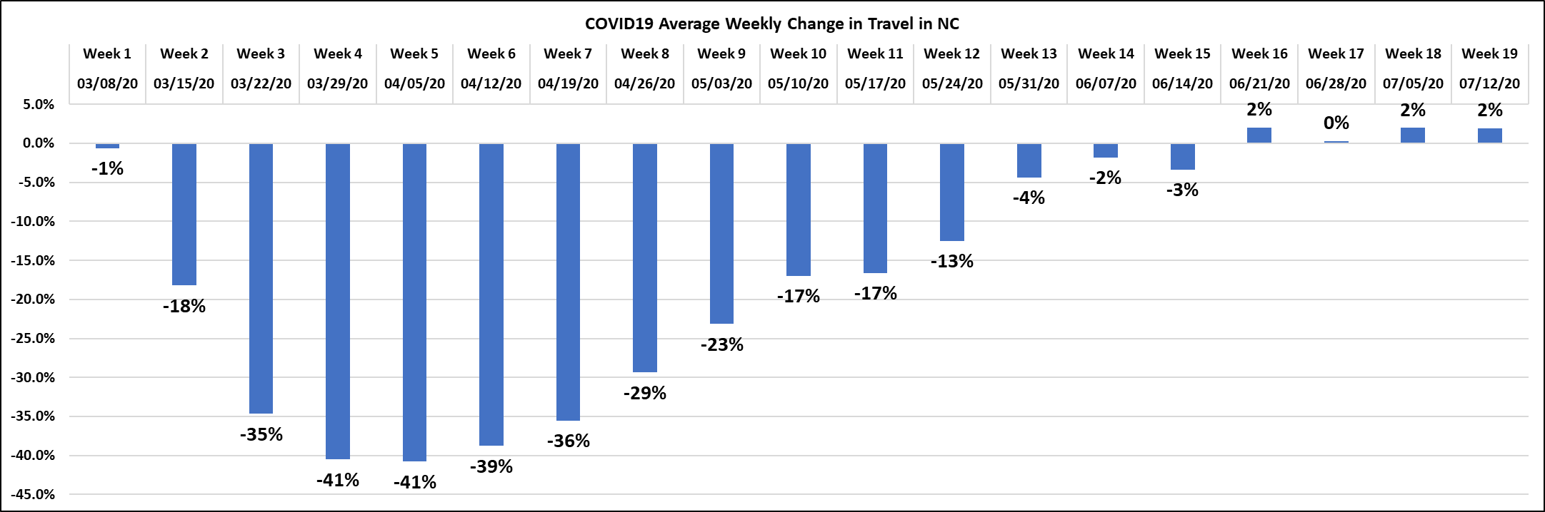
Volume Trend – Weekly Change
COVID-19 Travel Trends in NC
Weekly Change: Average of daily changes from Pre COVID volumes

Slide 27
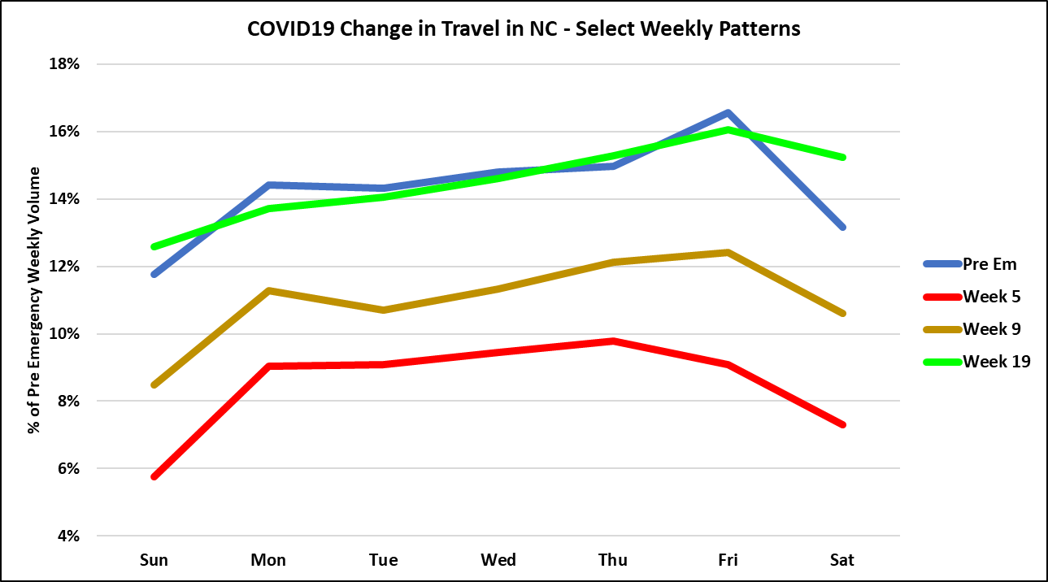
Volume Trend – Day of Week
COVID-19 Travel Trends in NC
Compares day of week impacts for selected weeks

Slide 28
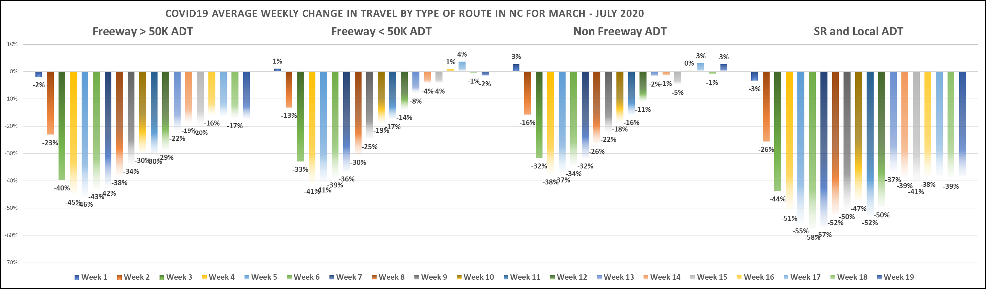
Volume Trend – Type of Route
COVID-19 Travel Trends in NC
Compares variation of impacts by the type of route

Slide 29
Travel Trend – Based on VMT
COVID-19 Travel Trends in NC
A statistic used to measure travel is Vehicle Miles Traveled (VMT). It is generated by multiplying the length of a highway segment with its volume. The VMT travel reported for 2018 are:
US VMT was about 3.3 Trillion
NC VMT was about 121 Billion
Average monthly NC VMT was about 10 Billion
VMT varies by Day of Week
Lowest travel day in NC is typically Sunday around 300 Million
Highest travel day in NC is typically Friday around 420 Million
Statewide Daily VMT will vary due to seasonal variation, holidays, adverse weather, and major events.

Slide 30
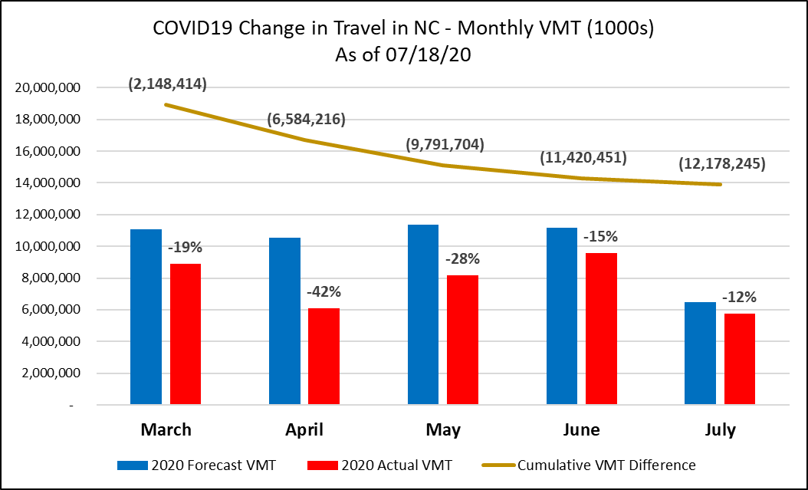
Travel Trend – Monthly
COVID-19 Travel Trends in NC
As of July 18th we have 12 Billion less VMT than forecasted

Slide 31
Travel Trend Contacts
COVID-19 Travel Trends in NC
Kerry Morrow Kent Taylor
Group Supervisor Traffic Data Resource Engineer
Traffic Survey Group Transportation Planning Division
kmorrow@ncdot.gov kltaylor@ncdot.gov
(919) 703-8031 (919) 345-9829

Slide 32
UCPRPO TCC Meeting
Edgecombe County - Johnston County – Nash County – Wilson County
September 1, 2020
9. Legislative Update
House Bill 77 was passed by the General Assembly and Governor Cooper allowed it to become law without his signature. The new law adjusts NCODT’s FY21 budget and implements governance measures and other modifications related to NCDOT operations. Key elements of the bill are:
FY21 adjustments to the Highway Fund (which primarily funds maintenance and operations activities):
  $8.5 million reduction in Construction
  $65.7 million increase in Maintenance
  $17.8 million reduction in Powell Bill (Local Aid)
  $76.2 million reduction in Transit, Bicycle & Pedestrian
  $8.7 million reduction in Aviation
  $12.2 million reduction in Rail
  $0.8 million reduction in Division of Motor Vehicles
  $3.5 million reduction in Compensation, Benefits, Transfers & Reserves
  $7.7 million reduction in Capital Improvements
FY21 adjustments to the Highway Trust Fund (which primarily funds construction activities):
  $425.9 million reduction in STI funding
Increases in funding for:
  General Maintenance Reserve ($84 million increase)
  Contract Resurfacing ($22 million increase)

Slide 33
UCPRPO TCC Meeting
Edgecombe County - Johnston County – Nash County – Wilson County
September 1, 2020
9. Legislative Update
Cont’d
Reductions in funding for:
  Mobility Modernization Program (zeroed-out, $41 million reduction)
  Powell Bill Program ($7 million reduction in recurring funds, $10 million reduction in non-recurring funds)
  State Secondary System ($9 million reduction)
  Commercial Airport Funds ($4 million reduction)
  State Aid to General Aviation Airports ($5 million reduction)
  Amtrak Payment Cap ($1 million reduction due to CARES Act provision)
  Freight Rail & Rail Crossing Safety Improvement Program ($11 million reduction)
  Lynx Blue Line Extension ($25 million reduction)
  Transit – State Maintenance Assistance Program (zeroed-out, $33 million reduction)
  Transit – Rural Operating Assistance Program (zeroed-out, $19 million reduction)
  DMV Headquarters Lease ($1 million reduction)
  Note: DMV has begun moving its headquarters to Rocky Mount
  Capital Repairs (zeroed-out, $8 million reduction)
  Elimination of 41 vacant positions at NCDOT ($4 million reduction)

Slide 34
UCPRPO TCC Meeting
Edgecombe County - Johnston County – Nash County – Wilson County
September 1, 2020
9. Legislative Update
Cont’d
Requires NCDOT to work with the Office of State Budget and Management on five-year revenue forecasts
Sets a floor on the gas tax rate through the end of 2021
Authorizes issuance of additional Build NC Bonds
Increases amount of permissible GARVEE funding
Directs more gas tax revenue into the Highway Fund (increase from 71% to 81% for FY21 sliding back to 75% by FY23) and less into the Highway Trust (decrease from 29% to 19% for FY21 sliding back to 25% by FY23)
Authorizes governor to call special session of General Assembly if needed to address funding related to an emergency situation
Makes changes to NCDOT’s required weekly “Cash Watch” reporting

Slide 35
UCPRPO TCC Meeting
Edgecombe County - Johnston County – Nash County – Wilson County
September 1, 2020
9. Legislative Update
Cont’d
Reorganizes the NC Board of Transportation and gives the board fiduciary responsibility:
  Increases board size from 19 to 20 by adding an additional at-large seat
  Makes General Assembly leadership responsible for appointing the six at-large members (Governor remains responsible for appointing the fourteen Division members)
  Sets new schedule of appointments, with terms for both Division 7 and 8 members coming up in 2022
Requires NCDOT to make monthly financial statement reports to the General Assembly, as well as a year-end report
Establishes a Transportation Oversight Manager position and requires restructuring of financial personnel within NCDOT
Requires an annual performance audit by the State Auditor
Requires third-quarter rebalancing of maintenance funds between Divisions
Requires an audit of NCDOT’s use of Advance Construction
The full document can be found at https://www.ncleg.gov/Sessions/2019/Bills/House/PDF/H77v8.pdf

Slide 36
UCPRPO TCC Meeting
Edgecombe County - Johnston County – Nash County – Wilson County
September 1, 2020
9. Legislative Update
Cont’d
JOINT LEGISLATIVE PROGRAM EVALUTION OVERSIGHT COMMITTEE MEETING
The Joint Legislative Program Evaluation Oversight Committee met on August 10, 2020 to receive a report that the Department of Transportation and Council of Internal Auditing did NOT ensure NCDOT followed the Internal Audit Act.
https://www.ncleg.net/PED/Reports/documents/DOT_InternalAudit/DOT_InternalAudit_Report.pdf
The Report’s Findings and Recommendations were:

Slide 37

Summary: Three Findings
DOT OIG failed to conduct types of internal audits that could have flagged overspending and cash flow problems identified by a national firm and the State Auditor
Majority of audits are misaligned with best practices concerning functional boundaries and independence
Council of Internal Auditing has been viable and active but has not probed or challenged the effectiveness of internal audit units

Slide 38
Summary: Three Recommendations
The General Assembly should direct the
State Board of Transportation Audit Committee to revisit DOT OIG’s annual plan and determine why OIG is not publishing reports
Council of Internal Auditing to conduct a hearing on DOT internal audit functions and assist DOT in improving the effectiveness of OIG
Council of Internal Auditing to establish and monitor compliance with standards for all internal
audit units within state agencies

Slide 39
UCPRPO TCC Meeting
Edgecombe County - Johnston County – Nash County – Wilson County
September 1, 2020
9. Legislative Update
Cont’d
The Joint Legislative Program Evaluation Oversight Committee did not pass the proposed legislation to present to the Joint Legislative Transportation Oversight Committee.
The JLPEOC Chair stated that he believed it would not be taken up by the General Assembly until after the November election and not until 2021.
Key take away is to expect additional legislation in addition to HB77 in response to the Department’s cash crisis and the State Auditor’s audit report.

Slide 40

UCPRPO TCC Meeting
Edgecombe County - Johnston County – Nash County – Wilson County
September 1, 2020
10. New NCDOT BOT Member for Division 4
North Carolina Department of Transportation’s Board of Transportation’s member representing Division 4, Gus Tullos, has stepped down after serving for over 12 years. He has served under four different administrations.
Mr. Tullos has represented Division 4 well. He was involved in ensuring the CCX project moved forward and moving the state Division of Motor Vehicles’ headquarters from Raleigh to Rocky Mount in Nash County.
We are very grateful for Gus Tullos’ service to improving transportation options in our Region and wish him the best.
The new NCDOT Board of Transportation member representing Division 4 is Melvin Mitchell. Melvin M. Mitchell of Rocky Mount as a representative of the fourth transportation division. Mitchell is the President and Proprietor of the Melvin Mitchell Agency, Inc., an Exclusive Agency with Allstate Insurance Company. Mitchell serves as Secretary on the Nash UNC Health Care Board of Commissioners. He also serves on the Rocky Mount Boys Club, Triangle Bank, Greater Rocky Mount Family Practice and on the board of directors for Providence Bank.

Slide 41
UCPRPO TCC Meeting
Edgecombe County - Johnston County – Nash County – Wilson County
September 1, 2020
11. US 70 Commission
Due to COVID-19, the US 70 Commission has not met since January 23, 2020.
The following project status was included in an email report provided by the the US 70 Commission.

Slide 42
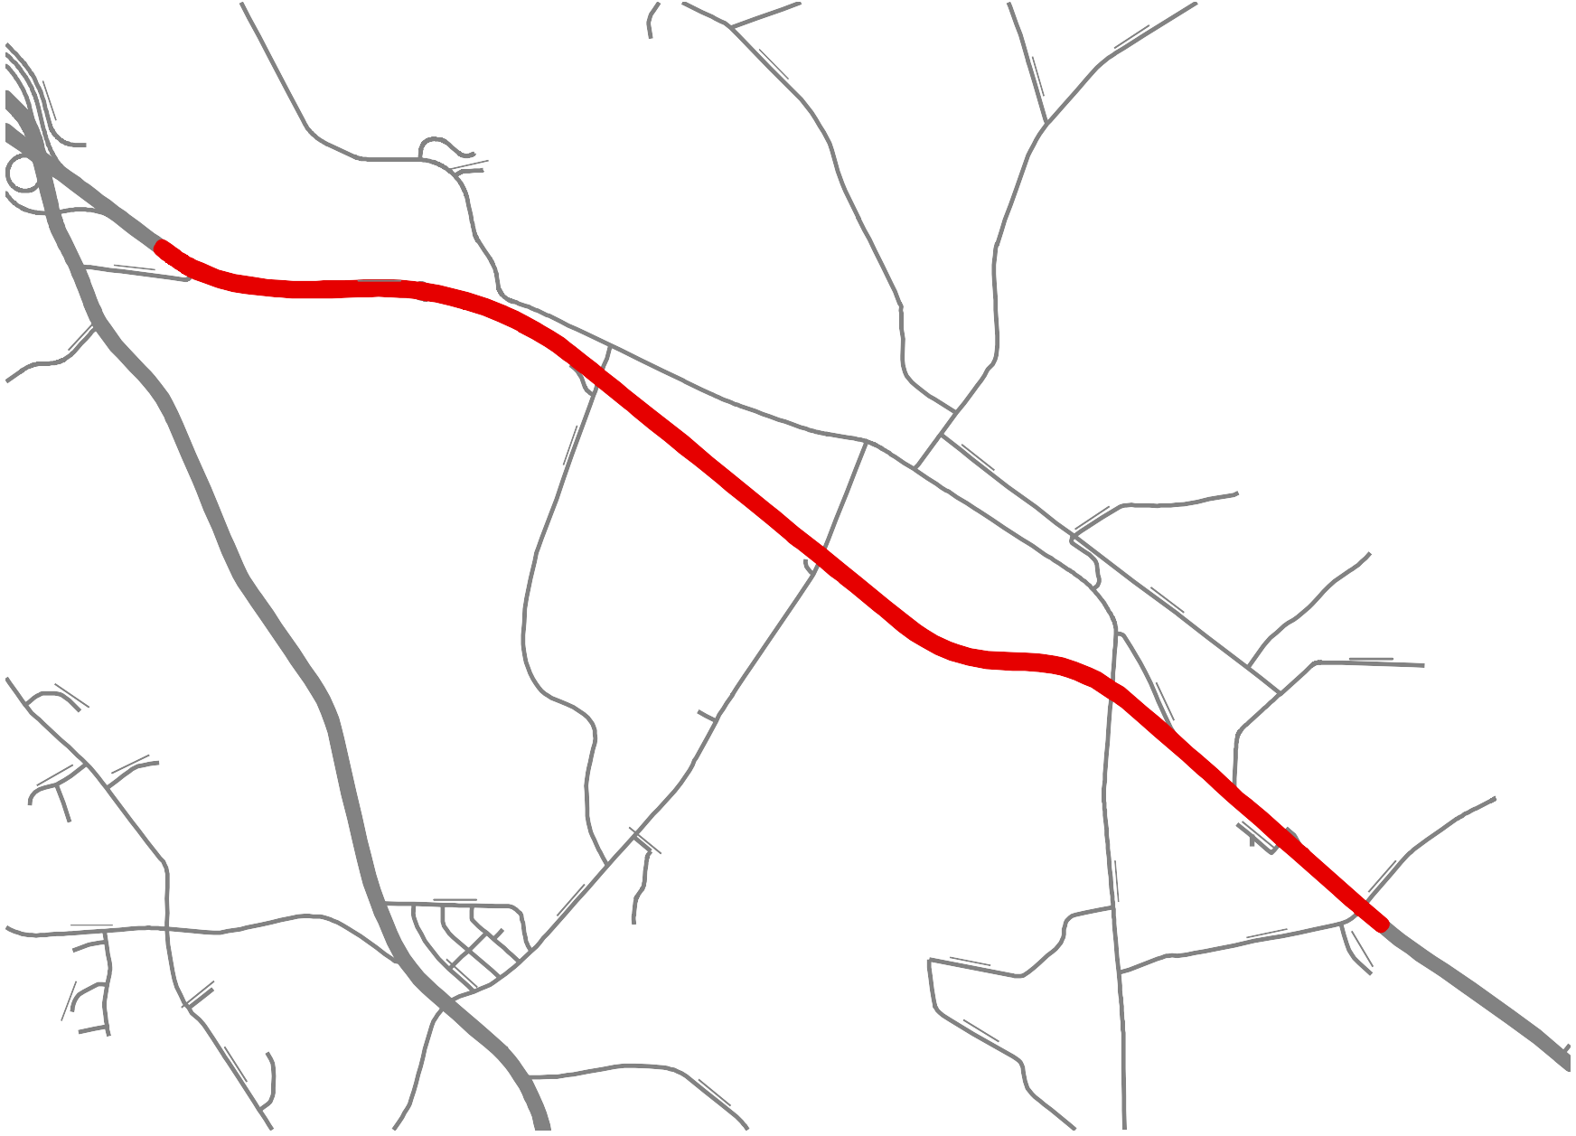
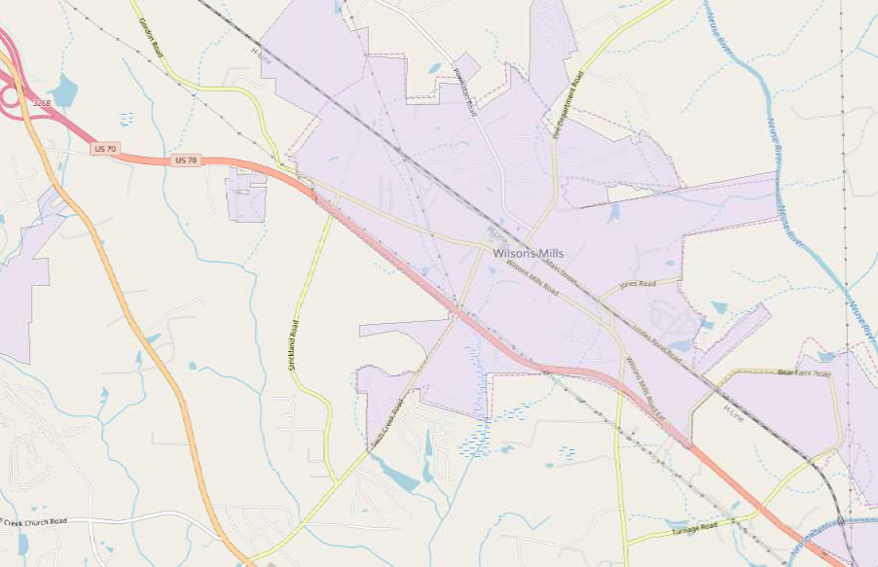
TIP: W-5600
US 70 Johnston
County
1901
1908
2816
1904
£¤
2844
Johnston
70
2566
2580
1586
¤£
1907
Wilson's Mills
1910
BUS
70
1911
_^
_^
W-5600
£¤
1912
70
1914
3150
2578
Selma
2244
3151
2802
2568
1598
1501
1913
2815
1563
1916
1915
2575
Legend
1983
6 ³ 7⁹
7 ¹ ₂0
₁ 7
₃ 4
1₅
7₂
_^
Interchange
1917
W-5600
1918
© OpenStreetMap (and) contributors, CC-BY-SA

Slide 43
W-5600
US 70 Improvements near Wilson's Mills - Johnston County
Project Description:
Upgrade US 70 to Interstate standards from US 70 Business to Neuse River.
Funding Status:
Fully funded in 2020-2029 STIP. Build NC Bond Project.
Schedule:
Project Scoping Meeting - July 2012
Public Meeting - February 2016
CE Approved - July 2016
Right of Way Acquisition – March 2018
Construction – Letting March 2021
Activities Underway
Right of way acquisition is substantially complete.
Utility relocations are underway.
Final plans are substantially complete.
Permits have been received.
Upcoming Actions
Finalize right of way acquisition.
Complete utility relocation.
Duke Transmission relocation - Summer 2021
Project letting and award - March 2021
Project Manager:
Addison Gainey, P.E., (252) 640-6400, nagainey@ncdot.gov

Slide 44
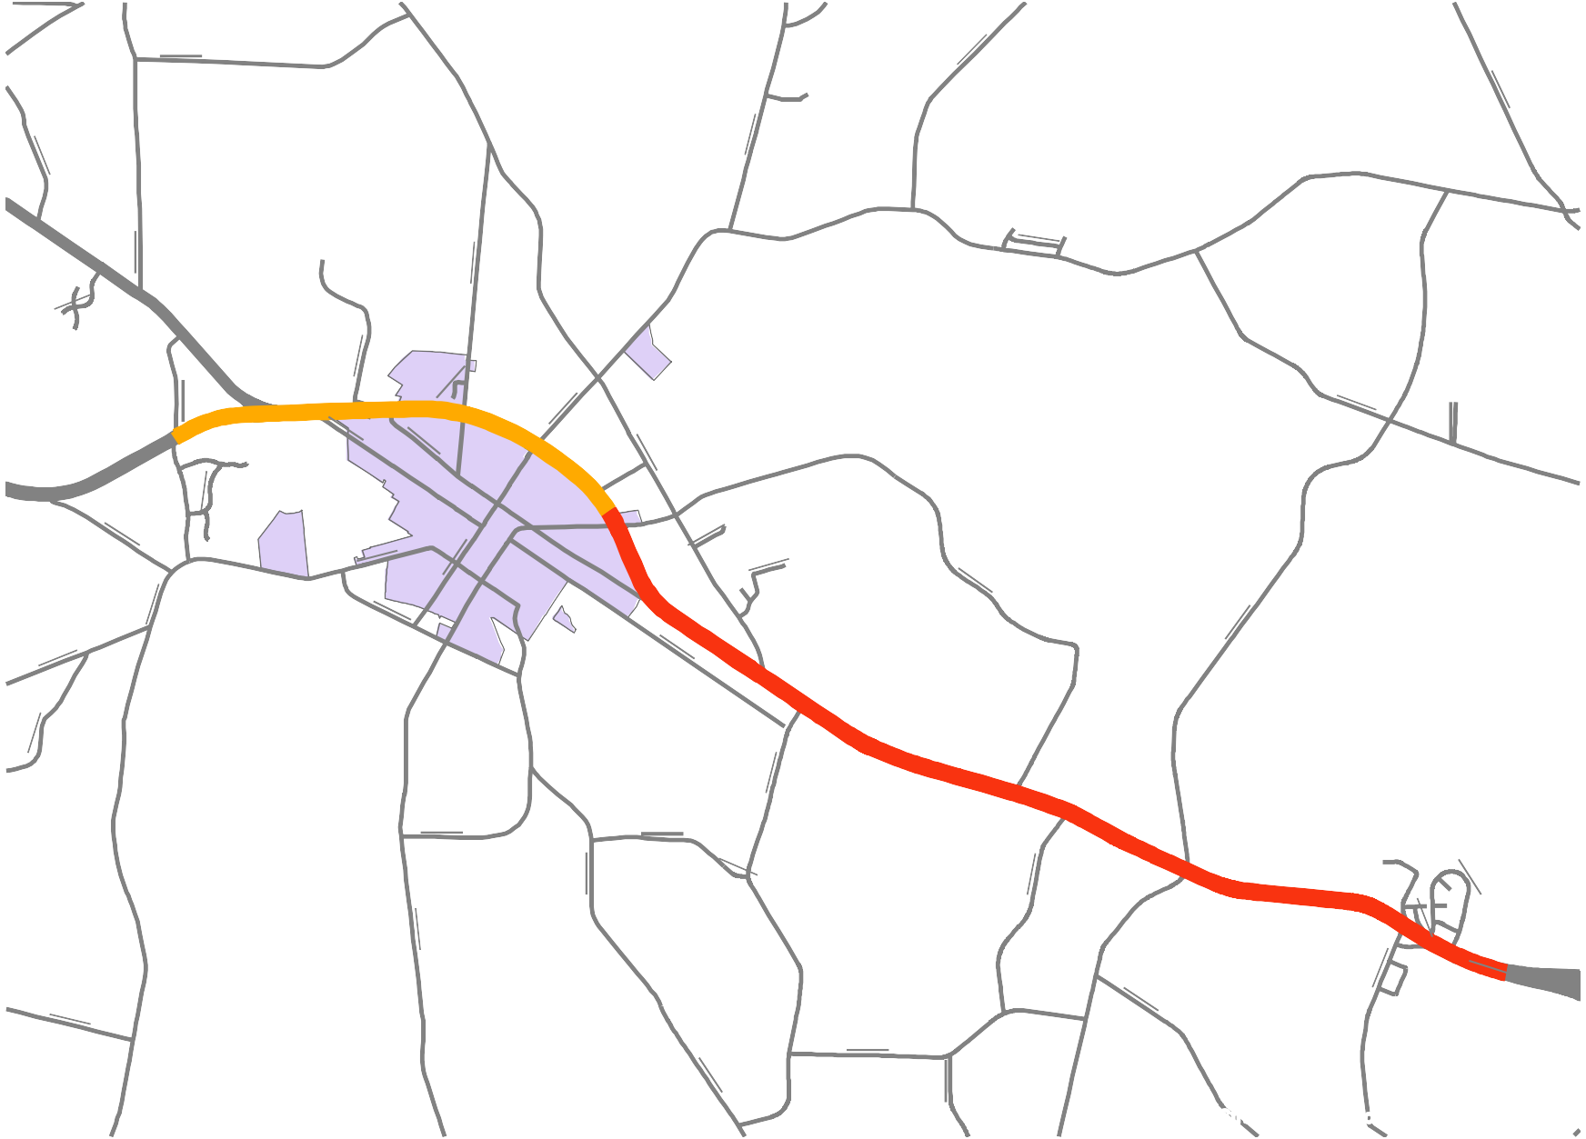
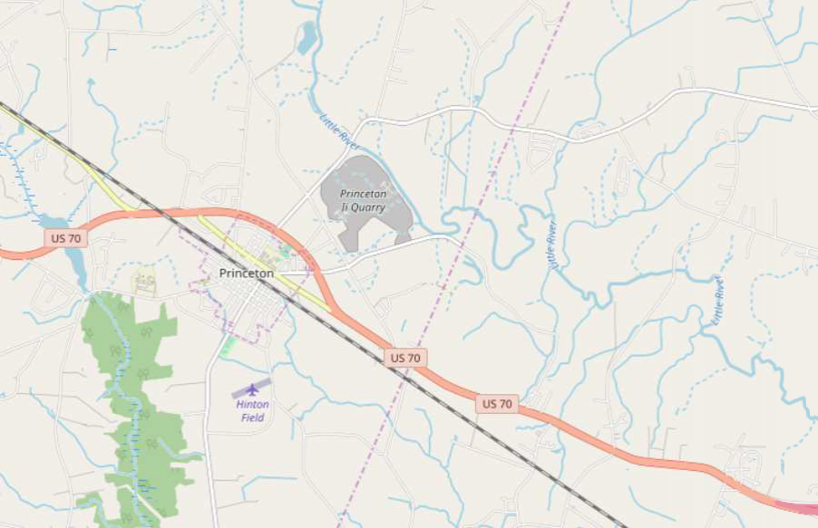
TIP: R-5829
US 70 Wayne - Johnston Counties
2317
2354
1333
2319
Johnston
2342
2318
2316
1488
2590
¤£
2315
2413
Wayne
2314
70
2532
1002
1330
1484
¤£
2556
2371
70
2594
R-5829B
2522
Princeton
2531
Princeton
2557
2534
2581
1331
2530
2533
2536
1234
2523
2527
¤£
1229
70
R-5829A
2537
2535
2538
1230
1232
1408
2372
1482
¤£
1235
1237
2160
70
2528
1231
1226
1233
© OpenStreetMap (and) contributors, CC-BY-SA

Slide 45
R-5829A & R-5829B
US 70 Improvements near Princeton - Johnston County
Project Description:
Upgrade US 70 to Interstate standards from US 70 Goldsboro Bypass to West of US 70A.
Funding Status:
Currently funded in 2020-2029 STIP.
Schedule:
Environmental Document (CE) - July 2019 (complete)
Final design currently on hold.
Right of Way Plans and Acquisition - R-5829A FY 2023
R-5829B FY 2025
Design Bid Build Let –
R-5829A FY 2027
R-5829B FY 2029
Upcoming Actions
Begin 25% plan development
Determine beginning date for Right of Way acquisition
Project Manager:
Addison Gainey, P.E., (252) 640-6400, nagainey@ncdot.gov

Slide 46
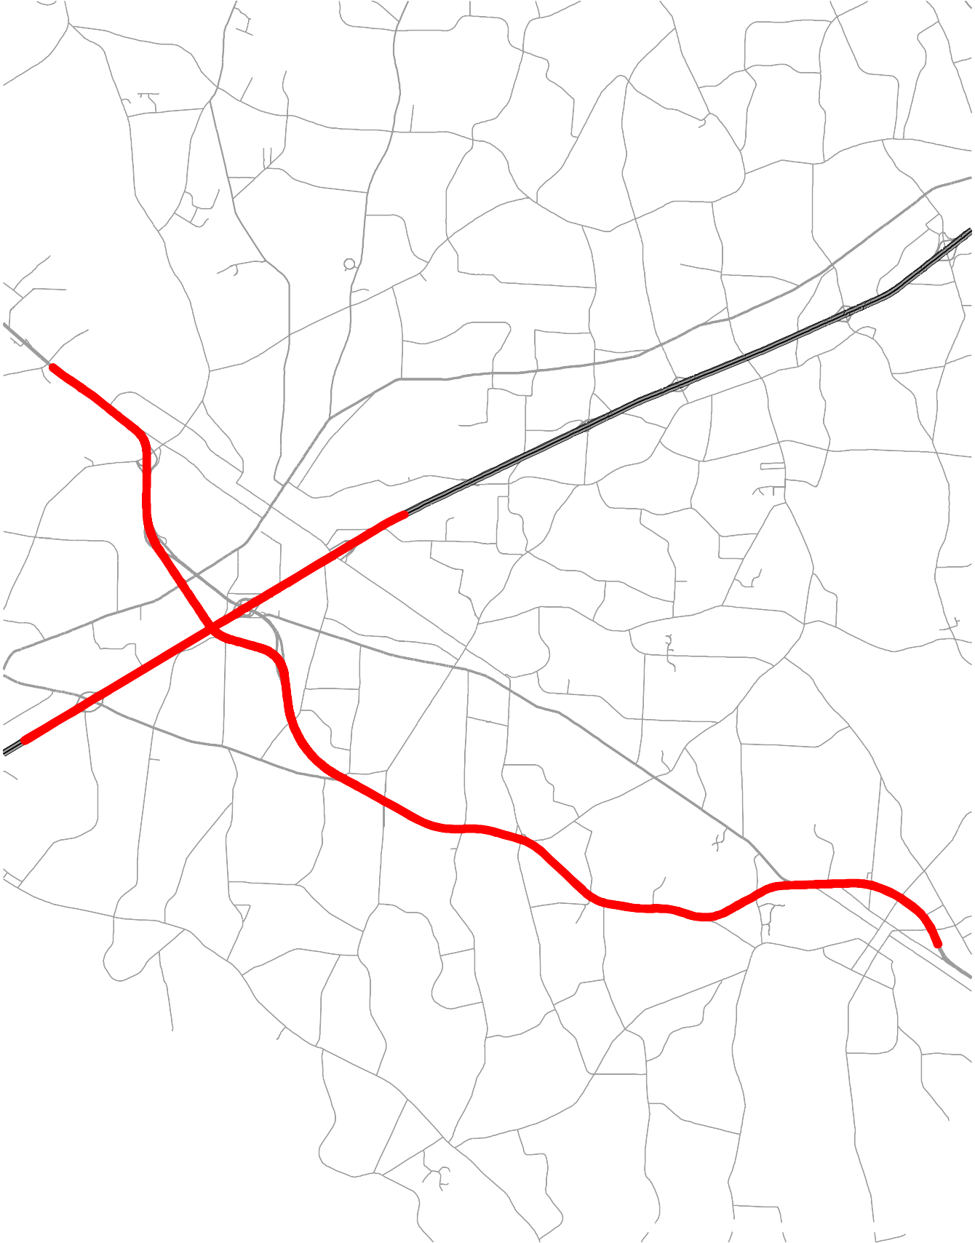
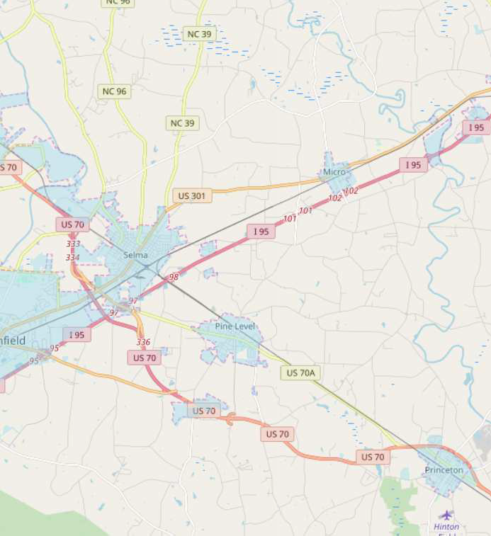
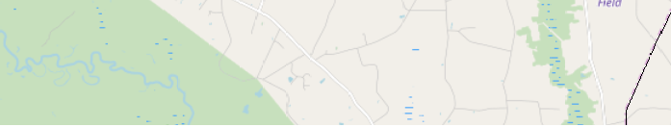
FS-1604A - US 70 Johnston County
¥
eo
96
eo
¤£
39
301
§¨¦
95
¤£
70
§¨¦
95
¤£
BYP
70
¤£
¤£
BYP
ALT
70
70
£¤
BUS
70
£¤
70
© OpenStreetMap (and) contributors, CC-BY-SA
Feasibility Study for US 70 from SR 1003 (Buffalo Road) near Selma to SR 2372 (Edwards Road) in Princeton Completed Date: August 2018
Link: https://connect.ncdot.gov/projects/planning/FeasibilityStudiesDocuments/Feasibility-Study_1604A_Report_2018.pdf

Slide 47
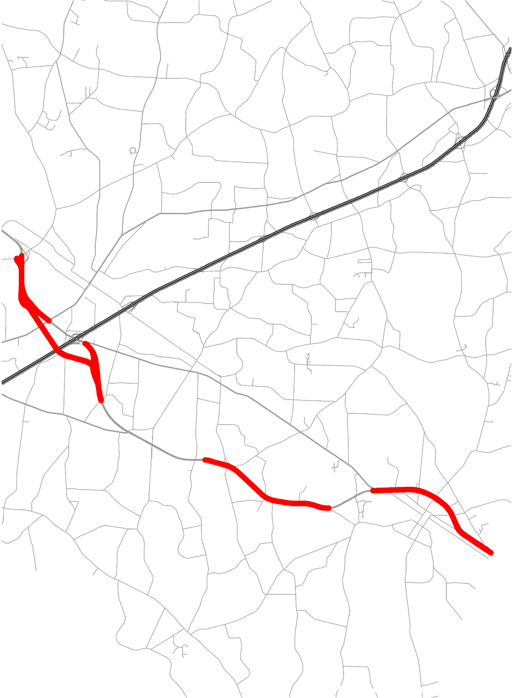
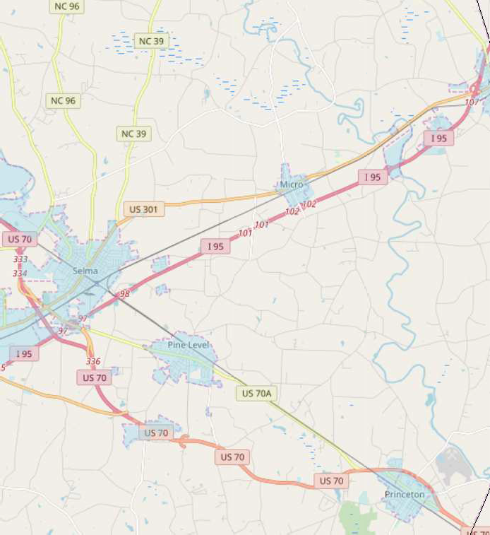
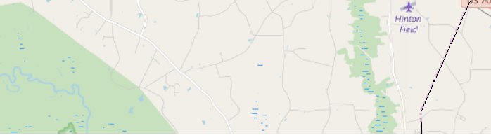
I-6044 - Interstate Maintenance US 70 Johnston County
¥
eo
222
eo
96
eo
¤£
39
301
§¨¦
95
§¨¦
95
¤£
BYP
70
¤£
¤£
BYP
ALT
70
70
£¤
BUS
70
£¤
70
¤£
70
© OpenStreetMap (and) contributors, CC-BY-SA
Awarded to ST Wooten Corp. for $4.76 M.
Project is 98% complete; Anticipated project completion in July 2020

Slide 48
UCPRPO TCC Meeting
Edgecombe County - Johnston County – Nash County – Wilson County
September 1, 2020
12. Hwy 17/64 Association
Due to COVID-19, the Highway 17/64 Association met virtually on July 29, 2020. The presentation provided by Marc Finlaysan was included in the agenda packet provided via email.
The next Hwy 17/64 Association next scheduled meeting is scheduled for September 20, 2020. Due to ongoing COVID-19 concerns the meeting will probably be held via Zoom.

Slide 49
UCPRPO TCC Meeting
Edgecombe County - Johnston County – Nash County – Wilson County
September 1, 2020
13. NCDOT Division 4 Update
Division 4 Update by:
Jimmy Eatmon, PE
Division 4 Planning Engineer
252-640-6431
jeatmon@ncdot.gov

Slide 50
UCPRPO TCC Meeting
Edgecombe County - Johnston County – Nash County – Wilson County
September 1, 2020
14. NCDOT Transportation Planning Division (TPD) Update
TPD Update by:
Carlos Moya-Astudillo, EI
Planning Engineer, TPD
919-707-0934
cemoya@ncdot.gov

Slide 51
UCPRPO TCC Meeting
Edgecombe County - Johnston County – Nash County – Wilson County
September 1, 2020
15. Public Comment
Public Comment

Slide 52
UCPRPO TCC Meeting
Edgecombe County - Johnston County – Nash County – Wilson County
September 1, 2020
16. TCC Member Comments
Are there any members whose TAC member does not have access to a Zoom virtual meeting?
Any additional TCC Member Comments…………

Slide 53
UCPRPO TCC Meeting
Edgecombe County - Johnston County – Nash County – Wilson County
September 1, 2020
17. Dates for future meetings
Future TCC Meeting Dates:
November 3, 2020
January 5, 2021
March 2, 2021
May 4, 2021

Slide 54
UCPRPO TCC Meeting
Edgecombe County - Johnston County – Nash County – Wilson County
September 1, 2020
Need a motion and a second for:
ADJOURNMENT
and
Roll Call
Next meeting: November 3, 2020

